Slide 1
NS-3 Simulation – Exp1
10.1.6.2
0
10.1.1.1
10.1.1.2
1
10.1.6.1
4
3
1
1
3
5
10.1.5.1
2
2
10.1.5.2
10.1.2.1
10.1.3.1
0.5Gbps
10.1.2.2
10.1.3.2
1
1
3
2
r Gbps
7
3
2
2
3
6
10.1.8.1
10.1.4.2
10.1.4.1
10.1.7.1
10.1.8.2
10.1.7.2
Flow 1: 4 -> 0 -> 1 -> 2 -> 3-> 7 (start at first)
Flow 2: 6-> 2 -> 3 -> 0 -> 1 -> 5 (start later)
Link speed of 1-2 is 0.5Gbps. Link speed of other links is 40Gbps.

Slide 2
NS-3 Simulation – Exp1
Simulation results:
r (Gbps) | 4 | 2 | 1 | 0.51 | 0.5 | 0.4
PFC deadlock | yes | yes | yes | yes | no | no
Corresponding testbed results:
r (Gbps) | 4 | 2 | 1 | 0.51 | 0.5 | 0.4
PFC deadlock | yes | yes | yes | yes | yes | no
Simulation results match testbed results well.

Slide 3
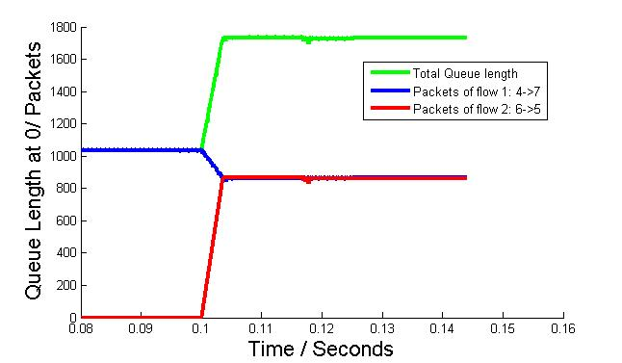
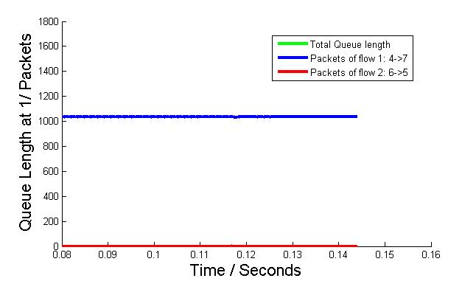
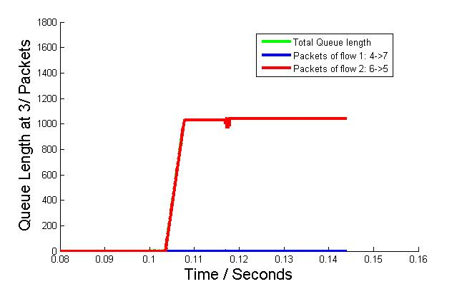
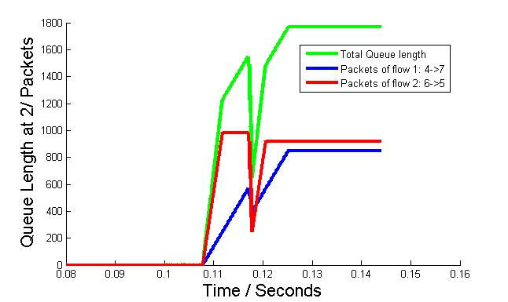
NS-3 Simulation – Exp1
Instant queue length of four switches when r = 2Gbps:

Slide 4
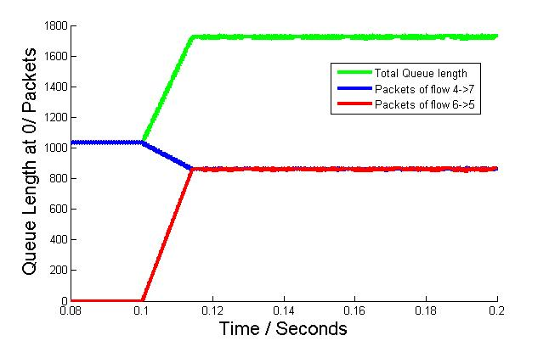
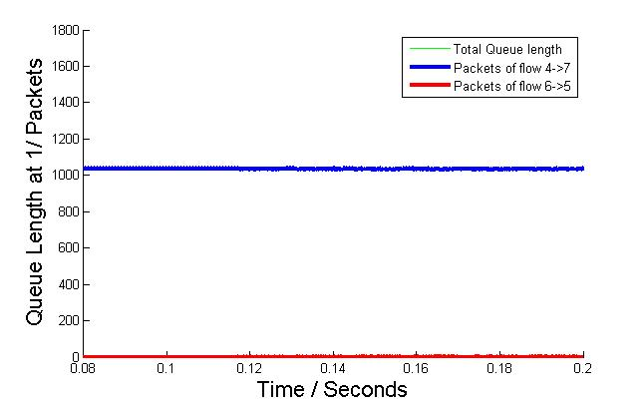
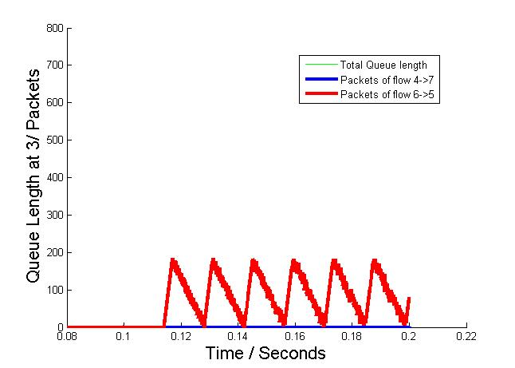
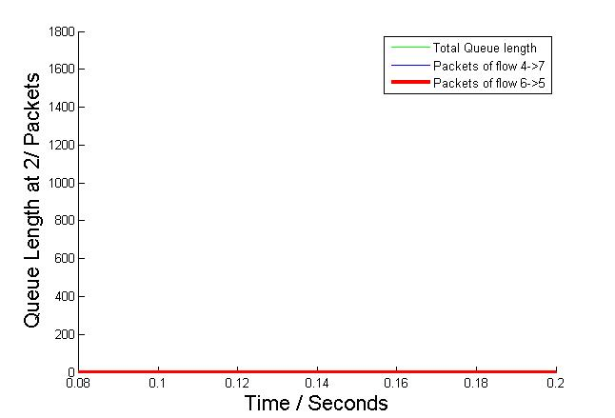
NS-3 Simulation – Exp1
Instant queue length of four switches when r = 0.5Gbps:

Slide 5
NS-3 Simulation – Exp2
10.1.6.2
0
10.1.1.1
10.1.1.2
1
10.1.6.1
4
3
1
1
3
5
10.1.5.1
2
2
10.1.5.2
10.1.2.1
10.1.3.1
10.1.2.2
10.1.3.2
1
1
0.5Gbps
3
2
r Gbps
7
3
2
2
3
6
10.1.8.1
10.1.4.2
10.1.4.1
10.1.7.1
10.1.8.2
10.1.7.2
Flow 1: 4 -> 0 -> 1 -> 2 -> 3-> 7 (start at first)
Flow 2: 6-> 2 -> 3 -> 0 -> 1 -> 5 (start later)
Link speed of 3-7 is 0.5Gbps. Link speed of other links is 40Gbps.

Slide 6
NS-3 Simulation – Exp2
Simulation results:
r (Gbps) | 6 | 4 | 2 | 1
PFC deadlock | no | no | no | no
Corresponding testbed results:
r (Gbps) | 6 | 4 | 2 | 1
PFC deadlock | yes | yes | no | no
Simulation results do not match testbed results.

